Slide 1
Designing Games for Educational Impact
Ira Fay, Brandon Patton, Dave Tomczyk
8/14/13

Slide 2
About Us
Nerdcore
Learning Logo
NASA Logo?
Other schools?
Notes:
It’s a pleasure to be part of this amazing project!

Slide 3
Overview
Game Design Crash Course
Practice!
Resources
Notes:
I teach an introduction to game design class, and I’m going to try to distill the most important parts here, and then we’re actually going to design games.

Slide 4
Why Study Game Design?
Notes:
1) Games bring people together across age, gender, culture, language.
2) Interdisciplinary pursuit
3) Still near the beginning of this industry. The first game was developed ~60 years ago. First films were double that (120 years). Music, Painting, Sculpture, Drama have been around for millennia.
Laparoscopic surgery. Game wasn’t even designed to help them, but it did. 2007. http://archsurg.ama-assn.org/cgi/content/short/142/2/181
First Person Shooters – driving at night, in the fog, peripheral vision. http://www.rochester.edu/news/show.php?id=3342
4) Growing industry

Slide 5
What is Game Design?
“Game design is the act of deciding what a game should be.” -Jesse Schell, The Art of Game Design
Notes:
Not necessarily programming, or art, or writing. Those skills help you make good decisions. Game developers vs. Game Designers.
Many decisions, over and over.
Everyone on the team can be a game designer – if you make decisions about how the game should be, then you are acting as a game designer.
“Should” is a key word. Not “will be”. There is a bit of moral implication to it, and I think that’s right. Anyone creating things for this world has some responsibility, IMO, to think about what it is they are creating.
Jesse Schell, Art of Game Design, pg xxiv

Slide 6
What are Game Design Skills?

Slide 7
Game Design Skills
Communication
Written, verbal, visual, aural, persuasive
Observing and listening
Playtesting
Creative thinking
Resourcefulness
Analytic thinking
Attention to detail
Teamwork

Slide 8
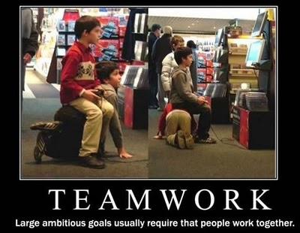
Teamwork
Notes:
Teamwork. Every work-related accomplishment has been done as part of a team. At Disney, at Z-Axis/Activision, at Pogo. It’s worthwhile to practice your teamwork skills.
I love working with interdisciplinary teams

Slide 9
Game Design Methodology
Notes:
Every discipline has its own methods.

Slide 10
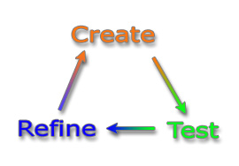
Iteration!
No one gets it right on the first try
More iterations lead to a better product
Notes:
Communication and teamwork happening throughout the loop.
Creative thinking happening during creation.
Analytic thinking happening during refine.
Observing and listening happens during the test. Game developers call this phase playtesting.

Slide 11
Game Design Skills
Communication
Written, verbal, visual, aural, persuasive
Observing and listening
Playtesting
Creative thinking
Resourcefulness
Analytic thinking
Attention to detail
Teamwork

Slide 12
Storytelling
Character
Location
Relationship
Conflict

Slide 13
Design a Game!
10 minutes to design a game with constraints:
Must require exactly TWO (2) players
Each game should take ~5 minutes
Include at least a little story

Slide 14
Examples
Rock Paper Scissors with power ups and items
Dexterity-based dice stacking
Connect Four with weird gravity
A guessing game with math
A co-op storytelling game
Remember you need a story!

Slide 15
Materials
Paper
Index Cards
Pens/Pencils
Dice
Playing Cards
Anything else you have with you!

Slide 16
Game Rules
Story (character, location, relationship, conflict)
Game Setup
Gameplay
Winning
Unlike this slide, use pictures & diagrams
Ordered lists are your friend!

Slide 17
Design a Game!
Must require exactly TWO (2) players
Each game should take ~5 minutes
Include at least a little story

Slide 18
Design a Game!
Must require exactly TWO (2) players
Each game should take ~5 minutes
Include at least a little story
Write your rules:
Story
Game Setup
Gameplay
Winning

Slide 19
Playtesting
Pair up
Introduce yourself
Create an environment of honest feedback
Listen carefully!
Notes:
~5 minutes each game:

Slide 20
Playtesting
What actually happened?
Who did what, who won, how long did it take?
What was confusing?
Did the players have fun? Why?
What should change to increase fun?
Notes:
~5 minutes each game:

Slide 21
Game Design Skills
Communication
Written, verbal, visual, aural, persuasive
Observing and listening
Playtesting
Creative thinking
Resourcefulness
Analytic thinking
Attention to detail
Teamwork

Slide 22
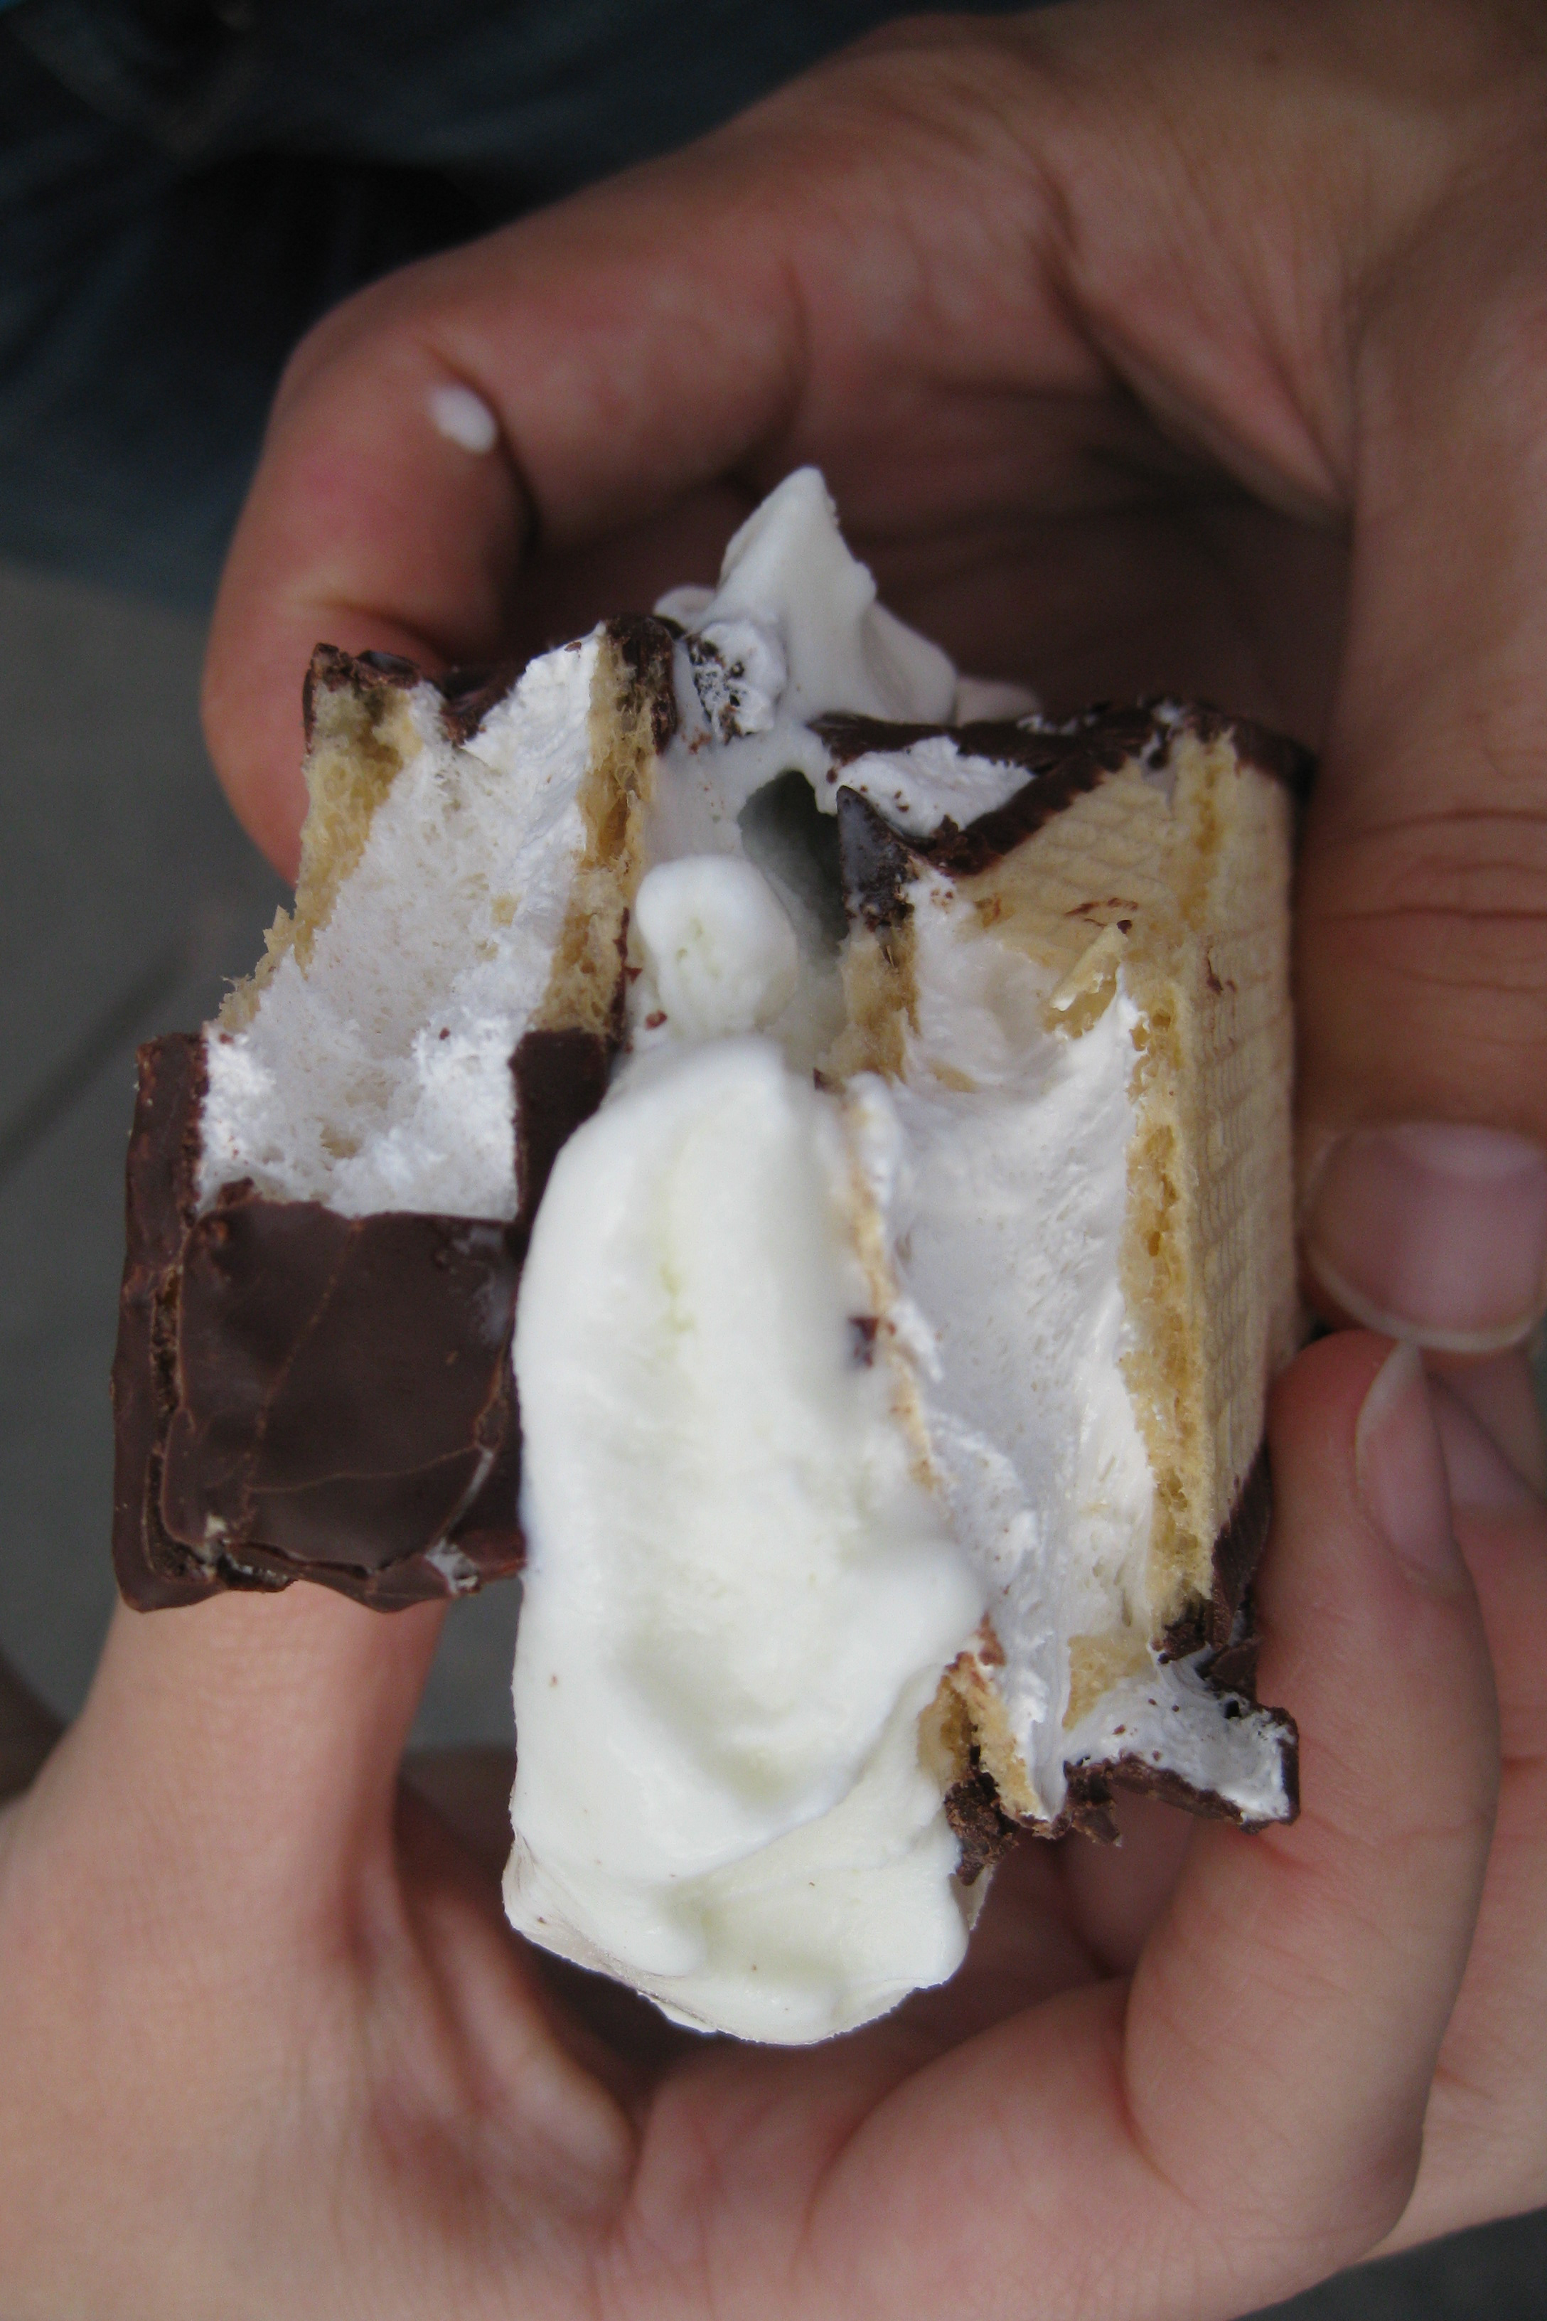
Thank you!
http://irafay.com/GenCon

